Slide 1
Our Final Plan
2022-2025
Notes:
All good things come to an end and Big Local not meant to last forever. Due to close in March 2025 so we’re entering into our final 2 years. Heard about some of the projects and activities we’ve funded over the last plan – going to have look forward to what we hope to achieve in the time remaining.

Slide 2
The Big Local Outcomes
Community | People | Making A Difference | A Better Place to Live
Notes:
Everything we do is underpinned by the 4 Big Local Outcomes – community, people, making a difference & a better place to live
Communities will be better able to identify local needs & take action in response to them
People will have increased skills & confidence so that they continue to identify and respond to needs in the future
The community will make a difference to the needs it prioritises
People will feel that their area is an even better place to live

Slide 3
Our Vision
Increase Community Engagement
Healthy Communities
Increased Pride in the area
Raise Aspirations
Notes:
As part of our final plan we came up with a legacy statement of what we want to see. We want to increase community engagement, ensuring residents’ voices, including those of young people, are heard and create opportunities for people to be part of decision-making. Part of our legacy will be a new community building at Moorsley which will be led by the needs and wishes of local residents, and we want people to be involved in the setting up and delivery of services on offer.
We know the health data for the local area is not great and we want to support our communities to be healthier, removing barriers to exercise and healthy eating, reducing social isolation which contributes to poor mental health and leave behind a legacy of improved health & wellbeing.
We want people to feel proud of where they live and to contribute towards it being a better place to live, so that they have a sense of belonging. That will have an impact on incidents of anti social behaviour and crime that people have told us is one of their main concerns
Finally we want to raise aspirations, not just for our children and young people, but for everyone living and working in the area. We want to provide opportunities for people to come up with great ideas and solutions to issues, create a legacy of community engagement and show that change is possible.

Slide 4
Our Story So Far
Commissioned and funded Community Transport scheme
A dedicated COVID-19 response fund impacting the wider community - £32k awarded
A community gym based at Easington Lane Primary School
Mindful Walking from 2 community locations
Skate Park in partnership with Sunderland City Council
Planning permission for New Hut achieved
Social Prescribing Pilot Programme
Commissioned and funded Young People programme
More than 42k awarded to local organisations through community fund grants
Notes:
Over the last two plans we have achieved a lot. When we set out the objectives for our last plan, no one was expecting a global pandemic to come along and that obviously had impact on what we could do but, our Covid 19 response showed that we can adapt quickly and adjust our way of working to continue to meet the needs of our community – we continued to offer mindfulness groups online, helped schools provide equipment for online learning, offered arts projects, suicide prevention support and even an online choir. We’ve heard from some of those projects today.

Slide 5
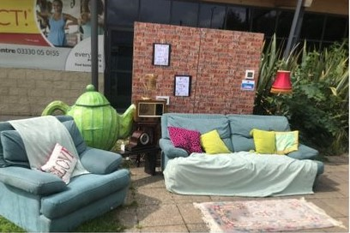
How do we know what our community wants?
Number of online surveys carried out in summer/autumn 2021
Creative consultation events held in 3 locations
Surveys distributed via local schools & Moorsley Hut
Community workshops
Continuing process
Notes:
Also looked at local data and used process to rank issues in terms of importance but also achievability – came up with our main themes for plan. Although we now have our plan, process of consultation is ongoing and you can still influence what we deliver – still want to hear from residents of all ages, including children & young people, about what you feel is important and what you would like to see happen in the area so there will be chance for you to give some feedback later but you can also get in touch with me or Emma at any time if you have an idea or want to get involved.

Slide 6
2022-2023 Review
Finalised new plan – began May 22
Planning permission for Hut in place & tender gone out
Mindful Walks continued from 2 locations
Contributed to Hetton200 celebrations
Free Bikeability sessions
Facilitated meeting of organisations to look at offering taster sessions for young people
New project officer in post – began Nov 22

Slide 7
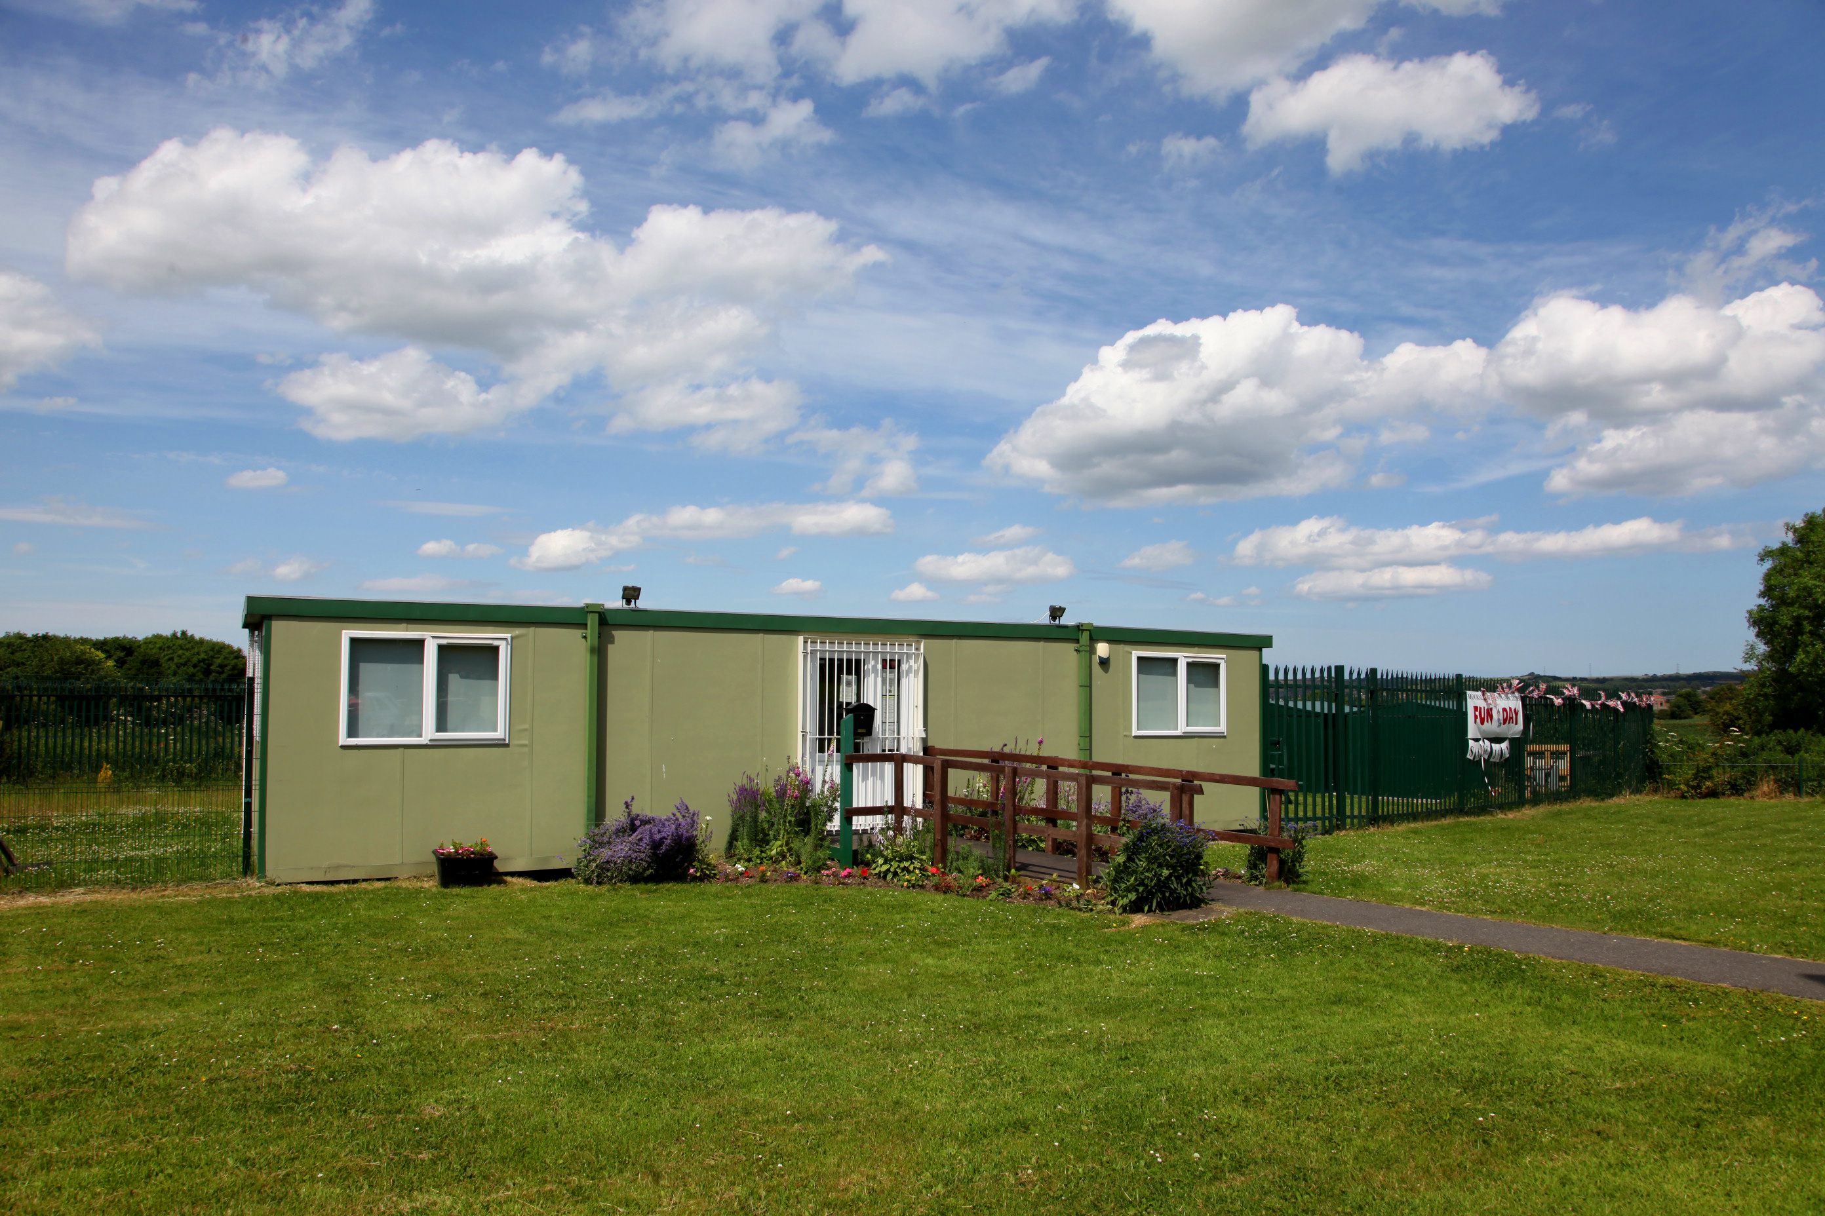
Community Resources
Residents wanted a community facility in Moorsley
What we plan to do:
New Moorsley Hut to be built
Support development of services from
the new building
Small grants fund
Notes:
We have some key themes in our new plan. First is around community resources. Completion of a new building to replace the Hut at Moorsley is a key priority. Planning permission is in place and funding has been secured from various organisations, including 3TBL, and tender has gone out with deadline for submissions on 10th Feb. Have been a few issues to sort out but hoping to have work started by June – should be short build period of 12 weeks so hope to be inviting you all to an official opening before the end of this year. Once building is complete, Moorsley CIC have lots of plans to expand what they deliver as we’ve heard from Jacky
As we talked about earlier, we will also be relaunching the small grants fund, including grants for capacity building and training where appropriate.

Slide 8
Environment
Residents told us they are concerned about environmental issues but don’t know how to help
Litter and flytipping were also priority for residents
What we plan to do:
Coordinate litter picks in area to ensure happening regularly and covering whole area
Talk to school eco-councils about their concerns and ideas
Notes:
We will be working in partnership with other organisations and agencies – linking in with HALO and Clean, Green Spaces projects around litter picking, involved with Elemore project and hoping to build on that partnership to develop work on this theme. Important that we involve our young people in this as they are very aware of the issues and will have lots of great ideas.

Slide 9
Heritage and Belonging
People valued sense of community and belonging and wanted to build on this.
Covid-19 made this even more important to people
Crime and anti-social behaviour was a key concern
What we plan to do:
Contributed to Hetton200 celebration
Work with children & young people to raise aspirations
Notes:
The theme of Heritage is so much more than knowing about the past. It links to understanding the individual, the place and to the future. It can create pride and a love of an area and a sense belonging somewhere. This can reduce crime, anti-social behaviour and to increase how safe we might feel. The theme links to raising aspirations and showing that change is possible.

Slide 10
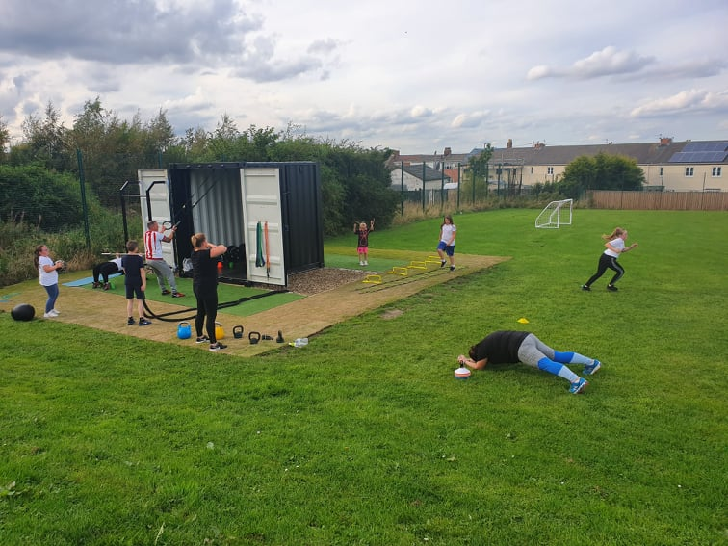
Health and Wellbeing
More free/low cost activities
Valued health and wellbeing activities provided previously
What we plan to do:
Re-establish free community fitness sessions at Gym in a Box
Establish resident-led community cycling hub at Elemore Park
Notes:
Will be restarting our free community fitness sessions after Easter – 4 sessions pw Mondays & Wednesdays 4.30-5.30 & 5.30-6.30. Got really good feedback from people who went along to Chris’s sessions before – you don’t need to be fit to go along, he adapts his sessions so inclusive of everyone no matter what your age or level of fitness
One of our main projects for next two years is setting up a community cycling hub at Elemore – what people have said is they want to be able to build up their confidence on a bike and to feel safe when out riding so we’re looking at providing some cycling confidence sessions and some regular led rides with emphasis on riding for fun and enjoying the social element whilst improving your physical fitness. Having talked to other cycle hubs in the area, it’s clear that they only work long-term if you have local volunteers engaged from the start. We can provide initial funding and support and get partners like Cycling UK on board but, ultimately, success will be down to whether enough local people want it and are prepared to help out. If that sounds like you or someone you know please speak to me.

Slide 11
Over to you
Do you have any comments about the plan?
What would you like to see happen in the key areas?
Would you like to get more involved?
Notes:
So those are our main themes for our final 2 years – there’s a lot of overlap between them e.g cycling hub is part of health & wellbeing but will be a community resource, will help with sense of belonging and, by promoting cycling for shorter journeys, also contributes to the environment theme.
As I said right at the beginning though, we want you to continue to shape the plan and what happens over the next 2 years and we want you to actively participate in the services and activities we develop. That might be the cycle hub or you might have a great idea around heritage or environment. There’s no such thing as a free lunch or tea in this case – there are some post it notes and sheets on the tables so, whilst you have something to eat, we’d like you to write down any comments or ideas on the post it notes and then stick them on the relevant sheet.
We will be setting up support groups around some of the themes or particular activities in them so, if there is something you have a burning passion for, or you’d like to be more involved then grab me or Emma. We’d love to have more of you involved.

Slide 12
Thank you for listening
Enjoy the buffet ☺

